Slide 1
Sheba
A Doctor finder Application

Slide 2
Group Members
Kamrun Nahar Sarna 1811209642
Md. Abdullah Al Mahfuz 1611869642
Mohammad Shakiruzzaman
1620180642
Omar Hasan Rumi 1813536642

Slide 3
What is your project?
Our Project is a web and android based application. The application is about doctor finder. In this application we are create a schedule based appointment system for patients, so that they can check and decide which time they want to take their appointment, this will reduce the wait time for the patient. The application will also have review system for patient and management system for the admin to add and remove doctors.

Slide 4
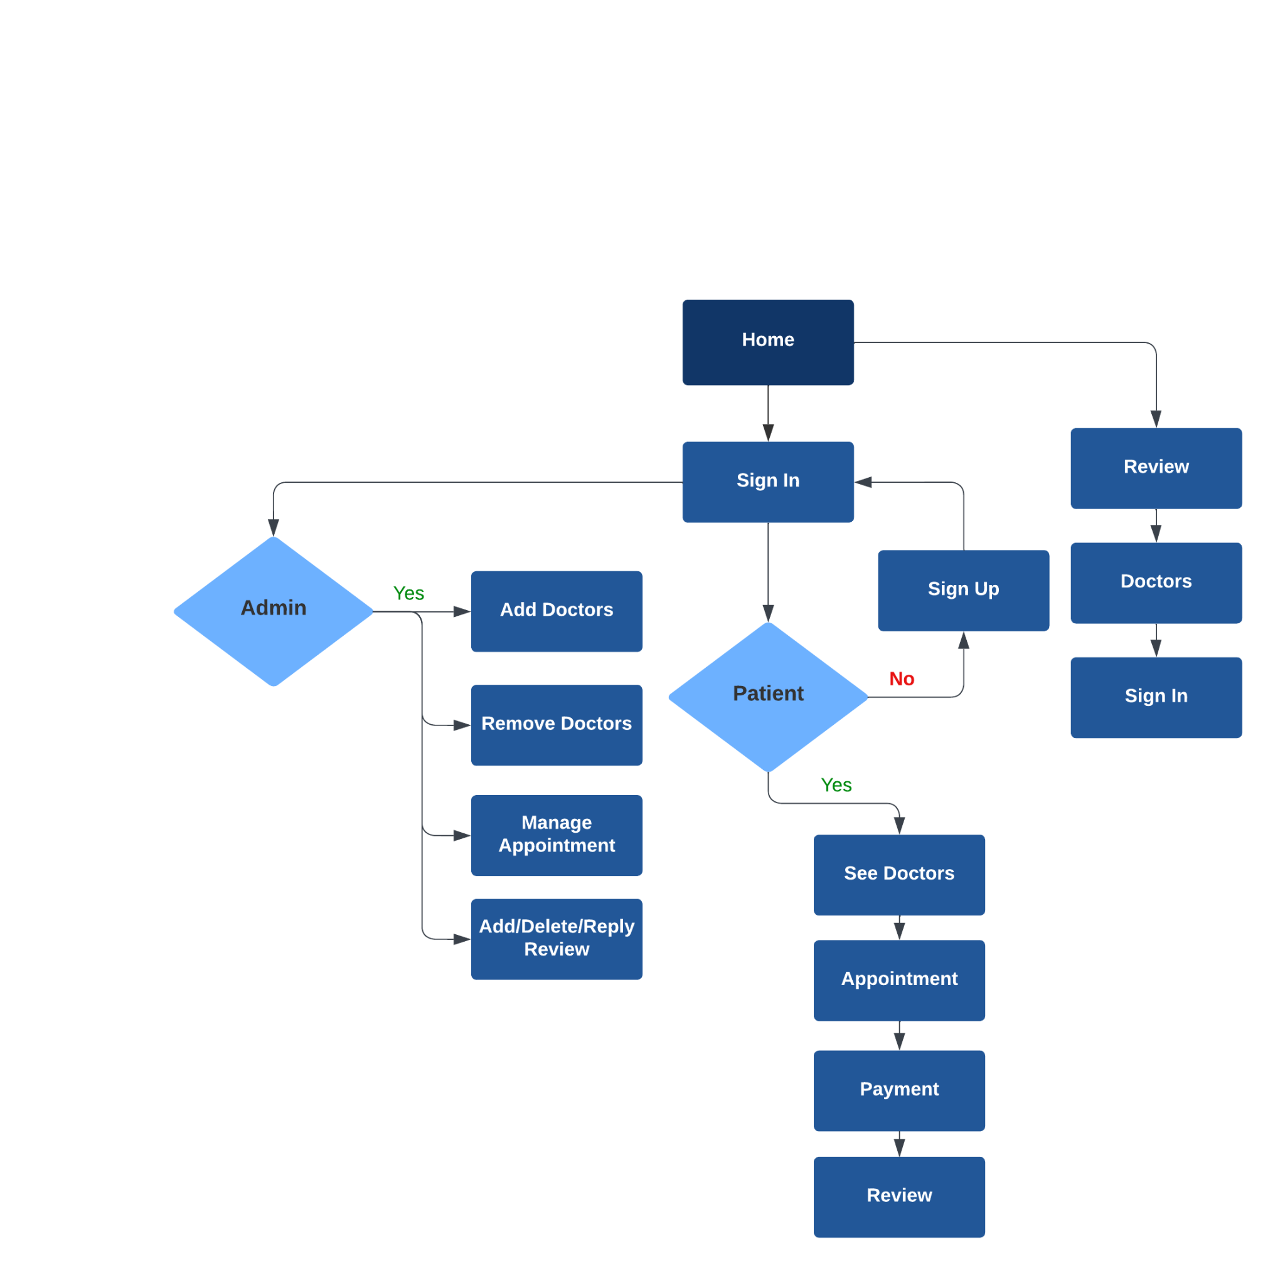
Flowchart

Slide 5
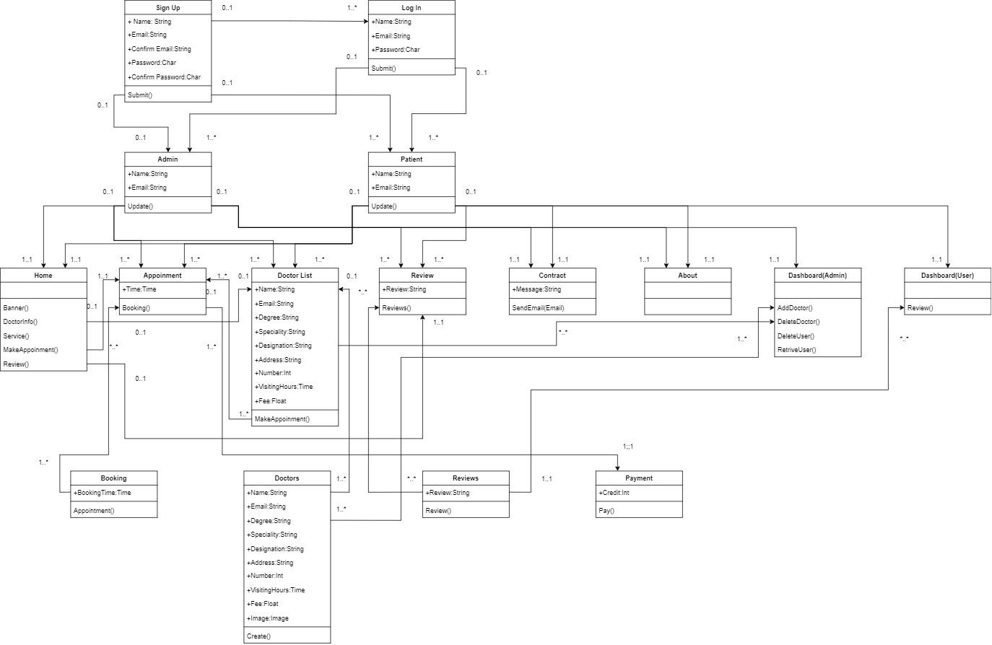
Class Diagram

Slide 6
specs
There is no single standard design for hospital management, as different hospitals have different needs and resources. However, a typical hospital management system would include modules for patient management, financial management, human resources management, inventory management, and reporting.
A standard design for a hospital management system typically includes the following components:
1. Patient Management 2. Clinical Management 3. Financial Management 4. Human Resources Management 5. Inventory Management 6. Reporting.
Here are some of the key specifications for a hospital management system:
1. User-Friendly Interface 2. Data Security 3. Compliance with Regulations. 4. Integration with Other Systems 5. Reporting and Analytics 6. Scalability 7. Customizability 8. Technical support.

